Slide 1
The search for τ → l γ at Belle and Belle II
Braden Moore
Under the supervision of Dr. Phillip Urquijo

Slide 2
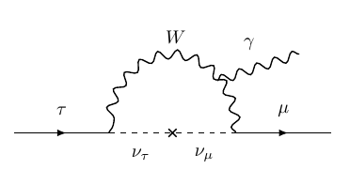
Introduction: τ → l γ
τ → l γ is a prohibited decay in the SM for massless neutrinos
extending the SM to include neutrino masses allows flavour mixing between generations → LFV can occur
even so, LFV in the SM + massive neutrinos is suppressed and is unobservably small
Figure 1: τ → μ γ via neutrino mixing
Notes:
highly calculable

Slide 3
Introduction: τ → l γ
unobservably small branching fraction for LFV processes allows New Physics (NP) to be probed without SM contamination
these LFV modes are highly calculable!
of the tau processes, τ → l γ decays most sensitive
why taus not muons? muons are easier to produce!
expected limit on branching fraction greater than μ → e γ due to tau mass
if this NP is Higgs-like, then would be seen more strongly in tau-sector (taus couple more strongly than muons to the Higgs)
Notes:
- recall Emilie’s slides (dipole enhancement)
- if Higgs like NP, couples stronger to Higgs
-

Slide 4
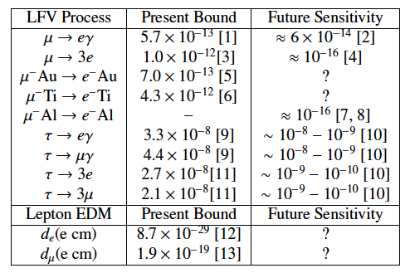
Other LFV
Table 1: Present and future experimental
sensitivities for LFV processes (Paradisi, 2015)

Slide 5
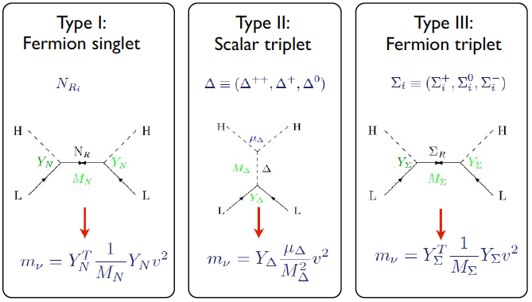
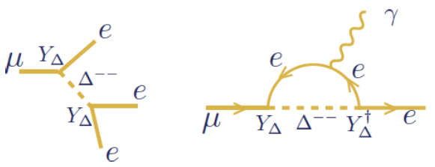
Neutrino mixing
lepton sector not fully understood (see: neutrino masses)
many mechanisms which explain neutrino mixing introduce LFV!
seesaw models, for example, can introduce new scalars which could couple with leptons to produce LFV
Figure 2: New particles introduced via seesaw models
Figure 3: LFV in Type-II seesaw
Notes:
- Deltas (scalars) are Higgs-like; tau could couple to doubly-charged Higgs which could mediate charged LFV

Slide 6
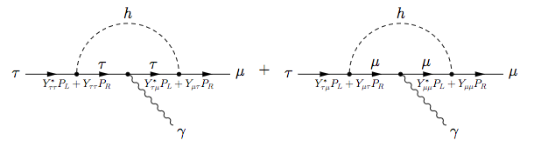
h → τ μ excess
CMS (2015) found 2.4σ excess in h → τ μ branching fraction
ATLAS (2015) found 1.2σ excess
LFV can occur naturally in models with more than one Higgs doublet, e.g. Type-II 2HDM
Figure 4: Diagrams contributing to τ → μ γ decay, mediated by a Higgs boson
with flavour violating Yukawa couplings (Harnick et al., 2012)
Notes:
-papers published 2015, results may have been earlier
-this branching fraction can be up to 10% in some 2HDMs (Diaz-Cruz, Toscano (2000))

Slide 7
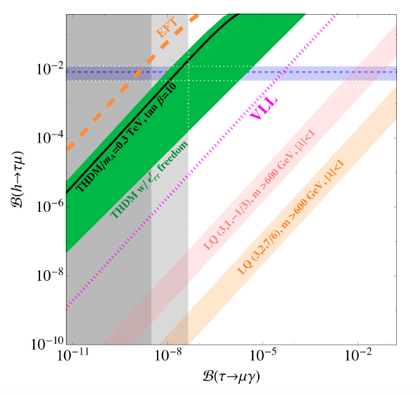
h → τ μ excess
horizontal lines are CMS 1σ bands on B(h → τ μ) (at 90% CL)
vertical lines are (right) current upper limit B(τ → μ γ) and (left)
Belle II expected sensitivity
under this model we would expect to find a signature in Belle II (!!)
Figure 5: B(h → τ μ) against B(τ → μ γ), with various ranges predicted by NP models (Dorsner et al., 2015)

Slide 8
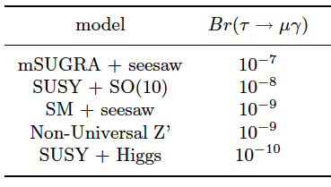
Models predicting τ → l γ
Table 2: Upper limits of branching fractions of τ → μ γ, predicted by models of new physics beyond the SM (various sources)
present and future bounds on LFV processes can reduce available phase space; determining branching fractions can rule out certain models
Notes:
- many NP models predict LFV to occur
- “Reduce parts of phase space”

Slide 9
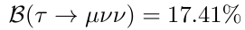
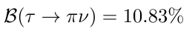
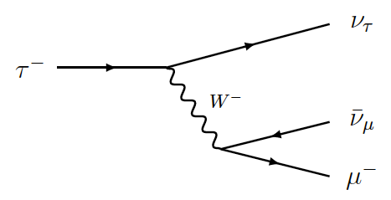
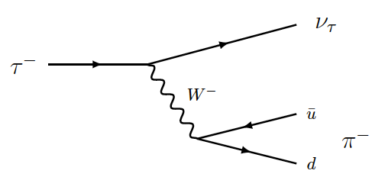
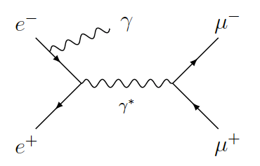
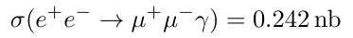
Key backgrounds
Figure 6: τ → μ ν ν diagram
Figure 7: τ → π ν diagram
Figure 8: e e → μ μ γ diagram
Notes:
Note: ee->tau tau cross section ~0.9nb (0.919nb)

Slide 10
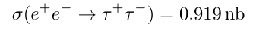
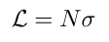
Belle & Belle II
Belle – 1000 fb⁻¹ of data (full run data)
e⁺ e⁻ → τ⁺ τ⁻ ~ 900 × 10⁶ tau-pairs
τ → μ ν ν ~ 150 × 10⁶ events
τ → π ν ~ 100 × 10⁶ events
e e → μ μ γ ~ 250 × 10⁶ events
Belle II – 50 ab⁻¹ (predicted luminosity)
e⁺ e⁻ → τ⁺ τ⁻ ~ 450 × 10⁸ tau-pairs
τ → μ ν ν ~ 75 × 10⁸ events
τ → π ν ~ 50 × 10⁸ events
e e → μ μ γ ~ 125 × 10⁸ events
× 50 more expected
total luminosity at
Belle II compared to Belle
Notes:
Note: - 5 ab-1 expected after ??
- 50 ab-1 expected when?
Belle finished running in 200x (??), Belle II predicted to collect first data from 20xx?

Slide 11
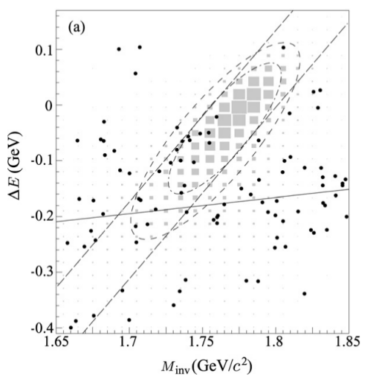
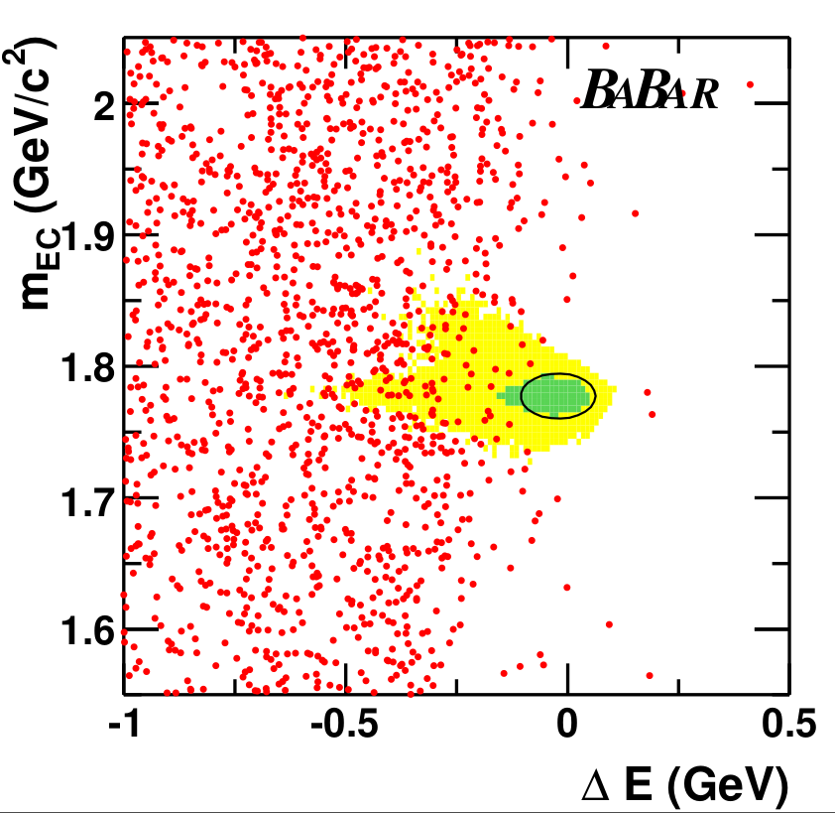
Current searches
Figure 9: M_{inv} - ΔE distribution in the search for τ → μ γ at Belle (Hayasaka, 2008)
Figure 10: M_{bc} - ΔE distribution in the search for
τ → μ γ at Babar (Babar Collaboration, 2010)

Slide 12
Future searches
Figure 11: Current and future sensitivities on
tau LFV branching fractions (Urquijo, 2016)

Slide 13
My search
approx 1.5 million signal (τ → μ γ) MC events produced
approx 3,500 million generic (tau-pair) MC events produced by the Belle II Collaboration
24 selection criteria added (based on previous Belle search)
cuts made to suppress various backgrounds
production and analysis being performed in basf2
currently optimising selection criteria for Belle II MC
analysis should be ready for Belle II first data
plan to optimise selection criteria for Belle MC also, to run over complete Belle dataset
Notes:
3,500 million with beam background, ~1,000 million without beam background
generic = ee->tau tau, both taus decay via SM processes (as given in PDG)
various backgrounds include bhabha, continuum suppression
requirements on one track being muon, other track(s) being not-muons

Slide 14
My search
Figure 12: M_{inv} - ΔE distribution for
signal MC (τ → μ γ) after selection cuts
(59,265 events out of 1,632,596)
Figure 13: M_{inv} - ΔE distribution for
background MC after selection cuts
(6 events out of 5,938,869)
Notes:
- ellipses represent 2-sigma bands of M_inv and Delta-E
- M_inv and Delta-E are correlated, so we must decorrelate them to determine signal region
- the ellipses are only indicative of the final signal region – they have not been calculated, only included to show what is expected

Slide 15
Belle & Belle II
Belle – 1000 fb⁻¹ of data (full run data)
e⁺ e⁻ → τ⁺ τ⁻ ~ 900 × 10⁶ tau-pairs
τ → μ ν ν ~ 150 × 10⁶ events
τ → π ν ~ 100 × 10⁶ events
e e → μ μ γ ~ 250 × 10⁶ events
Belle II – 50 ab⁻¹ (predicted luminosity)
e⁺ e⁻ → τ⁺ τ⁻ ~ 450 × 10⁸ tau-pairs
τ → μ ν ν ~ 75 × 10⁸ events
τ → π ν ~ 50 × 10⁸ events
e e → μ μ γ ~ 125 × 10⁸ events
× 50 more expected
total luminosity at
Belle II compared to Belle
at my current BG efficiency (10⁻⁴ %):
~10,000 background events
e e → μ μ γ background not
yet studied in my analysis
Notes:
Note: - 5 ab-1 expected after ??
- 50 ab-1 expected when?
Belle finished running in 200x (??), Belle II predicted to collect first data from 20xx?
- perhaps move this slide after I discuss My search (and my efficiencies)

Slide 16
Conclusion
LFV is an exciting place to search for new physics
lepton sector is not fully understood
negligible SM background means an observation would be an unambiguous signature of NP
analysis framework is being set up for Belle II data analyses (can be run over Belle and Belle II data)

Slide 17

Conclusion
Thank you for your attention!
Questions?

Slide 18
Backup

